Slide 1


MODE OPERATOIRE MACHINE
REF: EB – A26
MONTAGE / DEMONTAGE MANDRINS DE SOUFFLAGE
VERSION: 202501
PAGE: 1/8
MANDRINS DE SOUFFLAGE

Slide 2
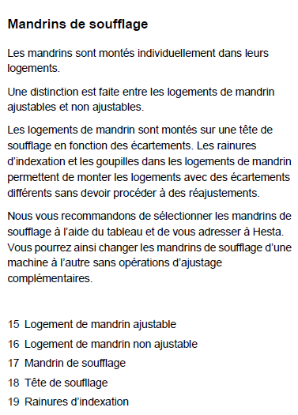
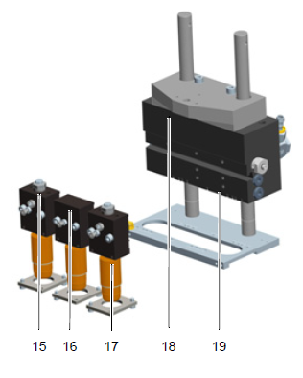
MODE OPERATOIRE MACHINE
REF: EB – A26
MONTAGE / DEMONTAGE MANDRINS DE SOUFFLAGE
VERSION: 202501
PAGE: 2/8

Slide 3
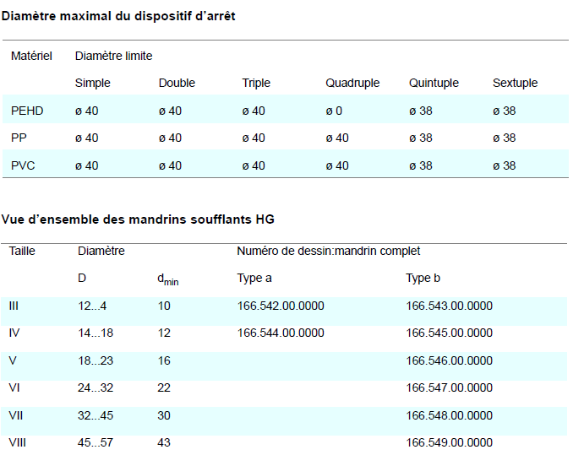
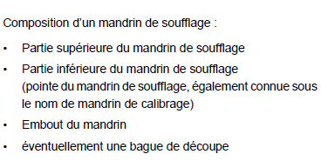
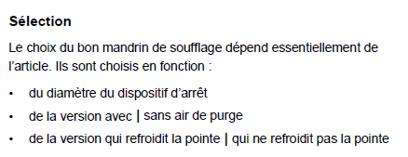
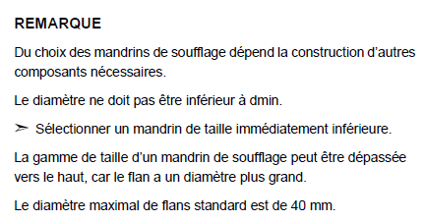
MODE OPERATOIRE MACHINE
REF: EB – A26
MONTAGE / DEMONTAGE MANDRINS DE SOUFFLAGE
VERSION: 202501
PAGE: 3/8

Slide 4
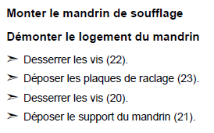
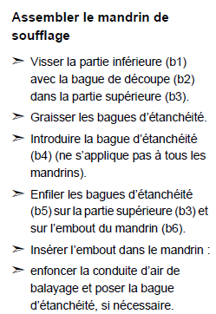
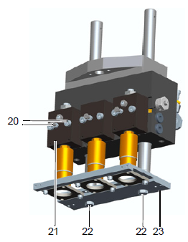
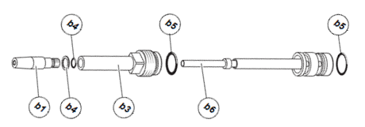
MODE OPERATOIRE MACHINE
REF: EB – A26
MONTAGE / DEMONTAGE MANDRINS DE SOUFFLAGE
VERSION: 202501
PAGE: 4/8

Slide 5
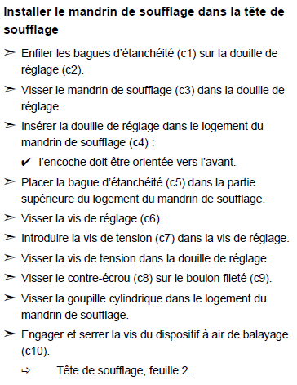
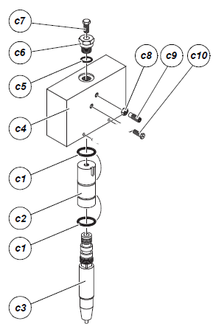
MODE OPERATOIRE MACHINE
REF: EB – A26
MONTAGE / DEMONTAGE MANDRINS DE SOUFFLAGE
VERSION: 202501
PAGE: 5/8

Slide 6
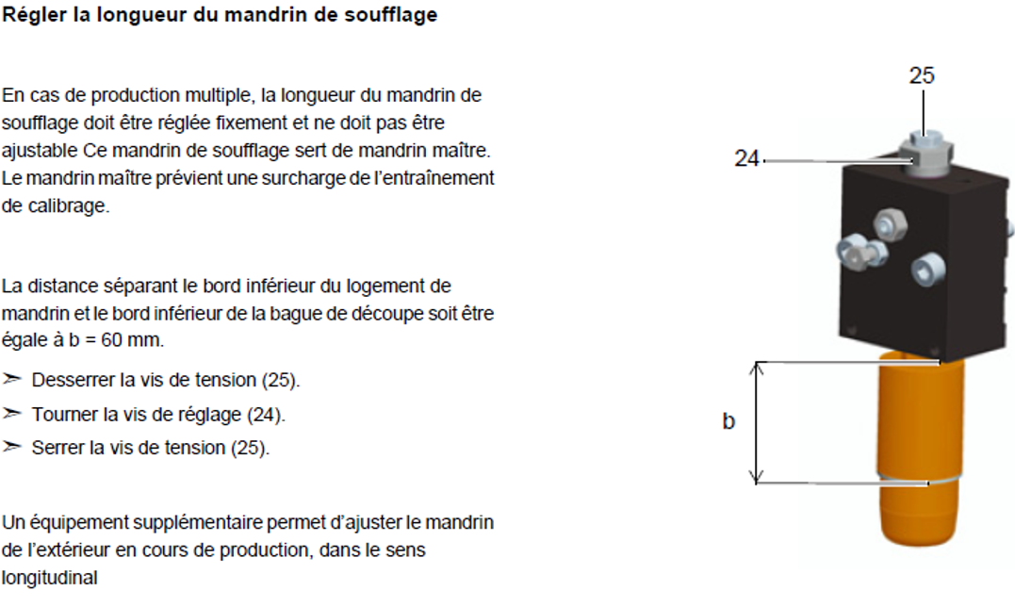
MODE OPERATOIRE MACHINE
REF: EB – A26
MONTAGE / DEMONTAGE MANDRINS DE SOUFFLAGE
VERSION: 202501
PAGE: 6/8

Slide 7
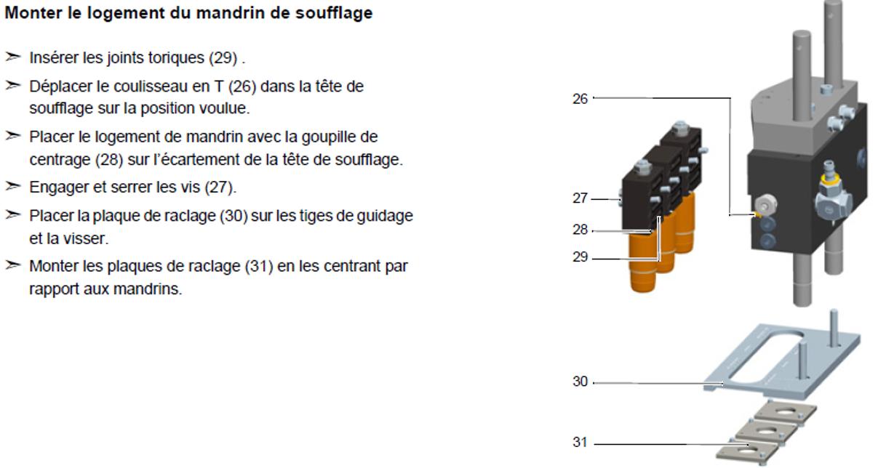
MODE OPERATOIRE MACHINE
REF: EB – A26
MONTAGE / DEMONTAGE MANDRINS DE SOUFFLAGE
VERSION: 202501
PAGE: 7/8

Slide 8
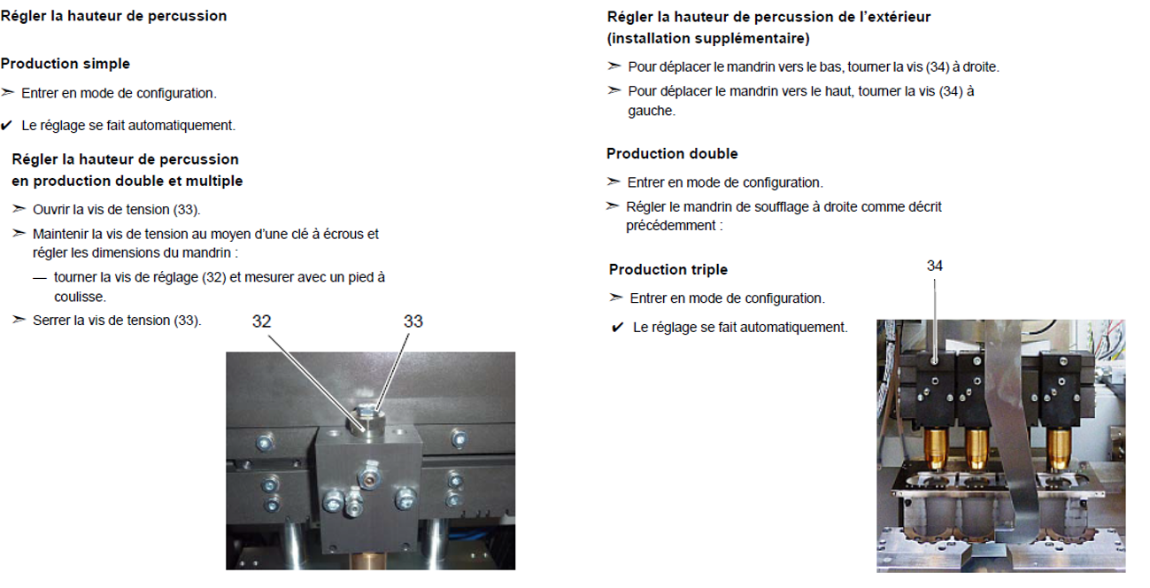
MODE OPERATOIRE MACHINE
REF: EB – A26
MONTAGE / DEMONTAGE MANDRINS DE SOUFFLAGE
VERSION: 202501
PAGE: 8/8

